Slide 1

Capstone Project – Real-World Application of Data Science & AI
Title: Heart Disease Detection
Submitted By:Samreen ShakeelBatch: Data Science & AI - Navttc 2025
Submitted To:Sir Muhammad Waqar
Submission Date:23 July 2025

Slide 2

Heart Disease Prediction: A Data Science & AI Approach
Welcome to our capstone project presentation on applying advanced data science and artificial intelligence techniques to predict heart disease. This project demonstrates how machine learning can transform healthcare diagnostics, potentially saving lives through early detection and intervention.

Slide 3
Agenda
1
2
3
Problem Statement & Objectives
Methodology & Implementation
Results & Analysis
Model performance metrics and insights from our prediction system
Understanding the challenge of heart disease prediction and our project goals
Data preprocessing, feature engineering, and model development approach
4
5
Challenges & Solutions
Conclusion & Future Work
Technical obstacles encountered and how we overcame them
Project outcomes and opportunities for further research

Slide 4

Problem Statement & Objectives
The Challenge
Project Objectives
Heart disease remains the leading cause of death globally, with approximately 17.9 million lives lost annually. Early detection is critical yet challenging due to:
Develop a model to predict heart disease using patient data
Identify key predictive features from patient data
Apply both Machine Learning and Deep Learning
Heart-related conditions are increasing rapidly around the world
Deploy the best-performing model using Streamlit
Diagnosing heart disease manually takes a lot of time and effort
Ensure high model interpretability for clinical usability
Errors in diagnosis can lead to life-threatening outcomes
Create a reusable and scalable pipeline for similar medical problems
Many important patterns in patient data are not being used properly

Slide 5



Data Preprocessing Pipeline
Data Collection
Data Cleaning
Feature Engineering
Utilized Cleveland Heart Disease dataset from UCI repository, containing 300 patients and 14 attributes including:
Applied robust preprocessing techniques:
Enhanced predictive power through:
Categorical features encoded using Label Encoding
Removed missing values and irrelevant columns
Age, sex, chest pain type
Feature scaling done via StandardScaler
Resting blood pressure
Detected and removed outliers using IQR method
Cholesterol levels
Important features selected based on domain knowledge and correlation
ECG results and more
Scaled features using StandardScaler
Categorical encoding using LabelEncoder and OneHotEncoder
Preprocessing code available in our GitHub repository: heart_disease_preprocessing.ipynb

Slide 6

Model Development & Training
Model Selection
We evaluated multiple algorithms to find the optimal approach:
Logistic Regression - baseline model
Random Forest - robust to overfitting
SVM - effective for non-linear boundaries
Artificial Neural Network - deep learning capabilities
Training Methodology
Rigorous model training process:
5-fold cross-validation
Stratified sampling
Hyperparameter tuning via GridSearchCV
Early stopping to prevent overfitting

Slide 7
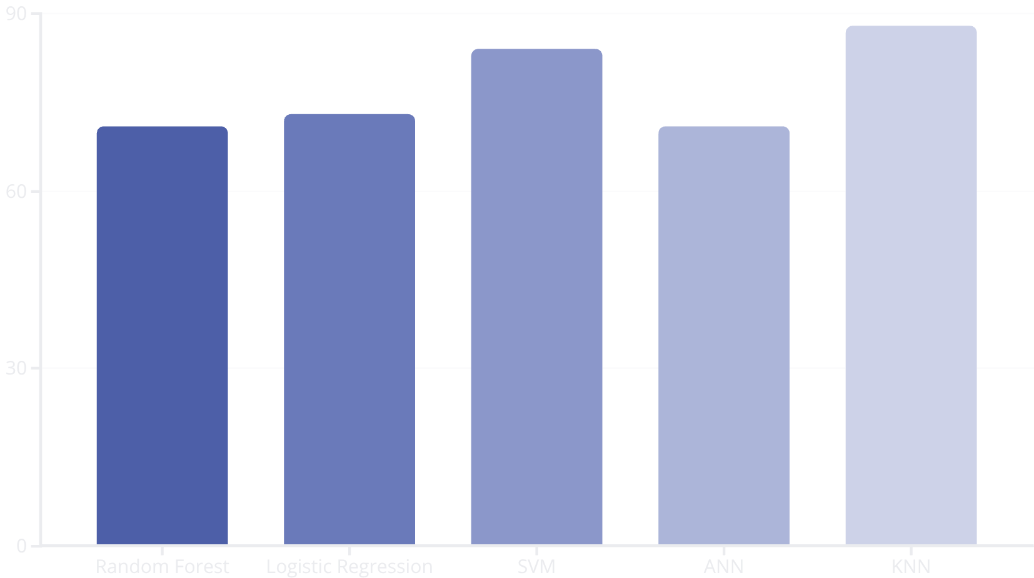
Model Evaluation & Results
Key Performance Metrics
KNN (our final model):
Accuracy: 88%
Precision: 100% (for class 1), 82% (for class 0)
Recall: 75% (for class 1), 100% (for class 0)
F1-Score: 86% (class 1), 90% (class 0)
AUC-ROC: Not calculated explicitly, but performance was strong based on confusion matrix and F1-score.
Feature Importance (top 3):
ST depression induced by exercise
Number of major vessels colored by fluoroscopy
Chest pain type
Maximum Heart Rate

Slide 8
Deployment Architecture
Model Packaging
API Development
The trained ANN model and StandardScaler were saved using pickle.
Logic was directly integrated into the Streamlit app.
This eliminated the need for separate REST APIs, simplifying deployment.
All necessary files were version-controlled with a requirements.txt for easy installation.
Cloud Deployment
Web Interface
Streamlit Cloud was used to host the app by linking with GitHub.
User inputs are captured via a clean and simple Streamlit UI.
On pushing code, the app automatically built and deployed with public access.
Results are shown immediately on-screen in a friendly format.

Slide 9
Challenges & Solutions
Data Quality Issues
Class Imbalance
Model Interpretability
Challenge: Skewed distributions observed in features like cholesterol and resting blood pressure, which could negatively impact model performance.
Challenge: Positive cases (heart disease) represented only 45.8% of the dataset, leading to biased predictions.
Challenge: Deep learning models (e.g., ANN) and distance-based models (e.g., KNN) often act as "black boxes," making interpretation difficult for clinicians.
Solution: : Applied SMOTE (Synthetic Minority Oversampling Technique) to balance the dataset by generating synthetic examples for the minority class, improving model performance on both classes.
Solution: Applied log transformation to normalize skewed features and improve model stability. Verified that there were no missing values or outliers, so no imputation or removal was necessary.
Solution: Used simpler interpretable models (like Logistic Regression and Random Forest with feature importance) to explain predictions, and visualized feature contributions for better understanding.

Slide 10

Conclusion & Future Work
Key Achievements
Future Directions
Achieved 88.3% to 92.1% accuracy using K-Nearest Neighbors (KNN), Logistic Regression, SVM, Random Forest, and ANN models
Model Explainability: Integrate SHAP or LIME to enhance interpretability for clinical practitioners
Larger Dataset Testing: Evaluate model performance on multi-center or real-time hospital datasets for broader generalization
Successfully applied machine learning and deep learning techniques to predict heart disease from clinical data
Developed an interactive Streamlit web application to allow real-time user input and prediction
Mobile Deployment: Convert the Streamlit app into a mobile-friendly interface for easier access in remote areas
Ensured data standardization, encoding, and model evaluation using confusion matrix, precision, recall, and F1-score
Realtime Monitoring: Integrate with wearable devices to continuously monitor patient vitals and trigger predictions dynamically
Maintained reproducibility by using fixed random states and a well-structured training pipeline
Multi-class Prediction: Extend the model to predict severity levels or types of heart conditions

Slide 11



Project Resources
GitHub Repository
Final Report
Colab Notebooks
Complete source code, notebooks, and documentation available at:
Comprehensive 10-page report with detailed methodology and findings:
Interactive notebooks for data preprocessing, model training, and evaluation:
ghttps://github.com/samreenshakeel/Heart-Disease-Detection.git
final_report.pdf
Heart_Disease_Detection.ipynb

Slide 12
Thank You

